Slide 1
FINAL- MINI PROJECT PRESENTATION Development of AI Based Diet Consultant application Programme: B. Tech in CSE
Mentor : Dr. Rinki Sharma
Group No. : 31
Team Leader : Pasupuleti Rohithsaidatta
Department : Computer Science

Slide 2
Project Team
Sl no. | Registration no. | Students
1 | 19ETCS002083 | Pasupuleti Rohithsaidatta
2 | 19ETCS002152 | Rakesh kumar
3 | 19ETCS002098 | Rakshith
4 | 19ETCS002066 | Jayendra
5 | 19ETCS002081 | Nithin Krishna

Slide 3
Outline
Title and Aim
Objectives
Modules
Design
Features and technology used
Results
Cost Estimation
Gantt Chart
References

Slide 4
Title
Development of Advanced AI Based Diet Consultant Application
Aim
To Create an application that efficiently help people to be healthy and delivering them with easier accessibility, to a new and innovative way towards the healthy lifestyle.

Slide 5
Introduction
Nowadays, people are suffering from many health issues due to lack of fitness and diet concerns. Therefore, we are developing this application to provide the AI dietician Consultant.
This AI based diet consultant and exercise application helps in providing customised daily diet and physical activities
The main advantage of using this AI basesd Diet Consultant application is it makes an efficient handy diet plan and physical challenges for every day to reach and maintain the fittest life of an individual cutting out the approach to real world dieticians in this busy day to day life

Slide 6
Introduction
Just similar to a human dietician, this web system will also act like your dietician. When you go to a doctor of nutrition, then she will ask you your personal details related to body and health such as your age, your height, your weight and how much water do your consumer in a day and how much walk to do take regularly and how much work do you do regularly. Just similar to this doctor, this artificial intelligent dietitian also asks you similar questions in your device and you have to answer all those questions and then this AI consultant will also advice you about what should your intake in your diet and what should you ignore in order to keep yourself healthy via your diet.

Slide 7
Objectives
Objectives of our AI Based Diet Consultant store are –
Gathering physical details such as pre medical histories, height & Weight (BMI) and physiological parameters
Identify the most appropriate predefined trained dataset
Generate the diet plan accordingly to the user diet preferences considering the pre medical histories from the user data and the food types .
Modify the diet plan based on the user feedback to the generated diet plan

Slide 8
Modules
Methods used to develop the are AI Based Diet Consultant are:
Admin Login
Add Dietitian:
System allows admin to add a dietitian details into the system who can create the diet plan for the users.
View/Edit Dietitian:
Can view and edit the dietitian details whenever required.
View User:
Can view the list of registered users with their details.
View Feedback
Can view feedback provided by the registered users.

Slide 9
Modules
User Login
Register:
To continue with the diet plan details, user first need to fill up all the required details.
Calculate BMI:
Based on details provided by the user, system automatically calculate the BMI of the user.
View Diet Plan:
The diet plan for the user is generated by the system itself using artificial intelligence.

Slide 10
Modules
Request Diet Plan:
If the user is unsatisfied with the diet plan provided by the system, the he/she can raise a request to generate the proper diet plan him/herself.
The diet plan request is forwarded to dietitian.
View Profile:
User can view his/her own profile.
Write Feedback:
Registered users can provide the feedback.

Slide 11
Modules
Dietitian Login
View Diet Plan Request:
Here, dietitian can view the diet plan request from the users.
Create Diet Plan:
Based on user’s request, dietitian creates a diet plan for him/her.
Update Diet Plan:
The user resends the request to dietitian about unsatisfied diet plan. So, as per the user’s request, dietitian regenerates the diet plan and sends to the user.
View User:
Can view user details as a when needed.

Slide 12
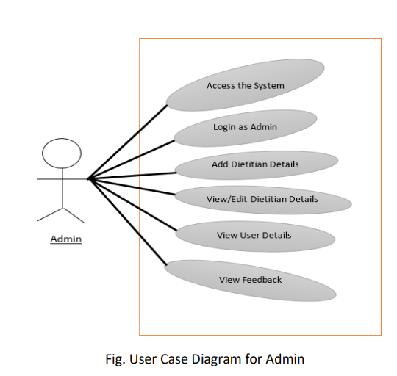
Design

Slide 13
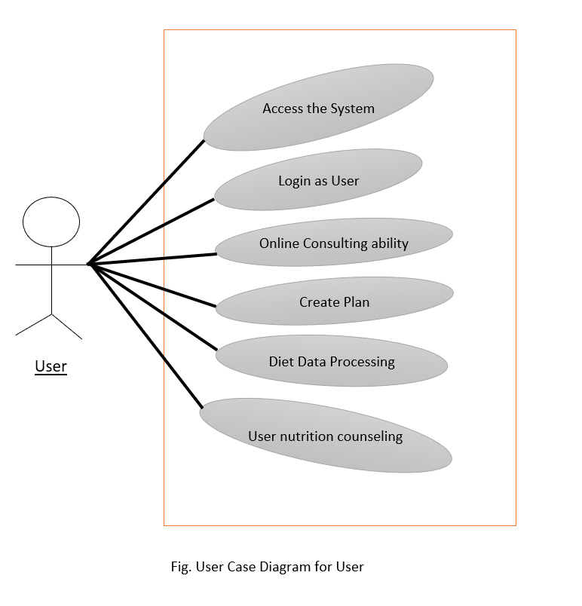
Design

Slide 14
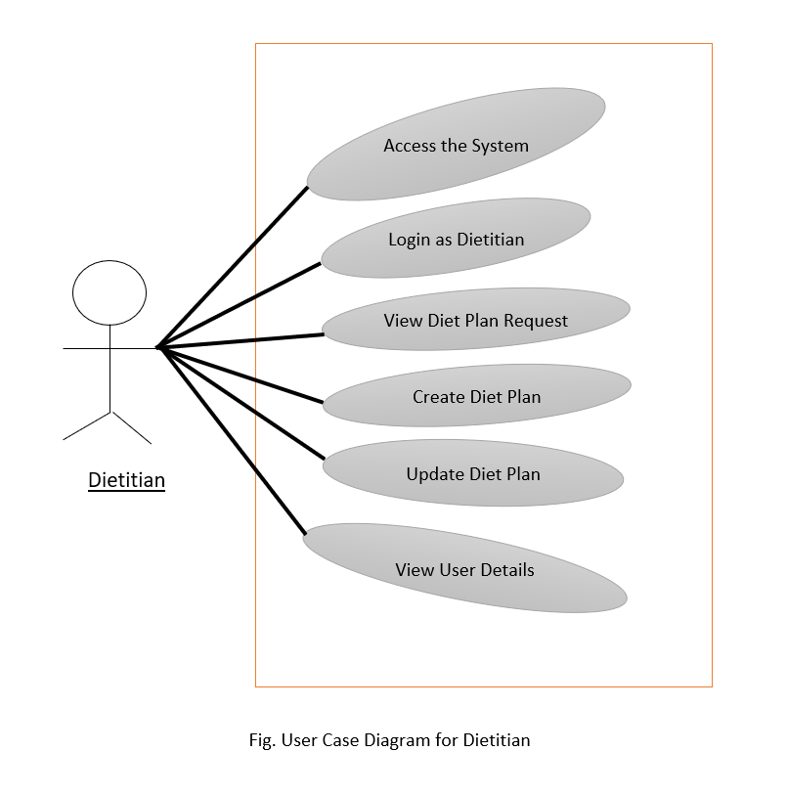
Design

Slide 15
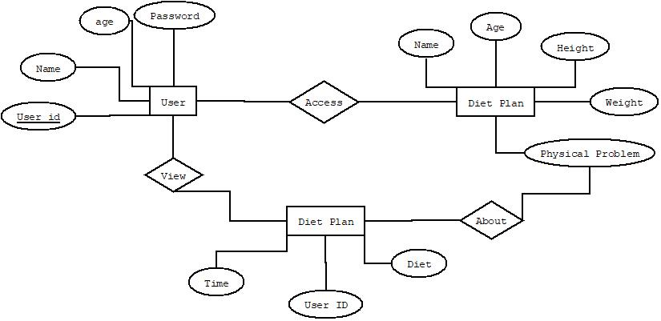
Design
ER Diagram

Slide 16
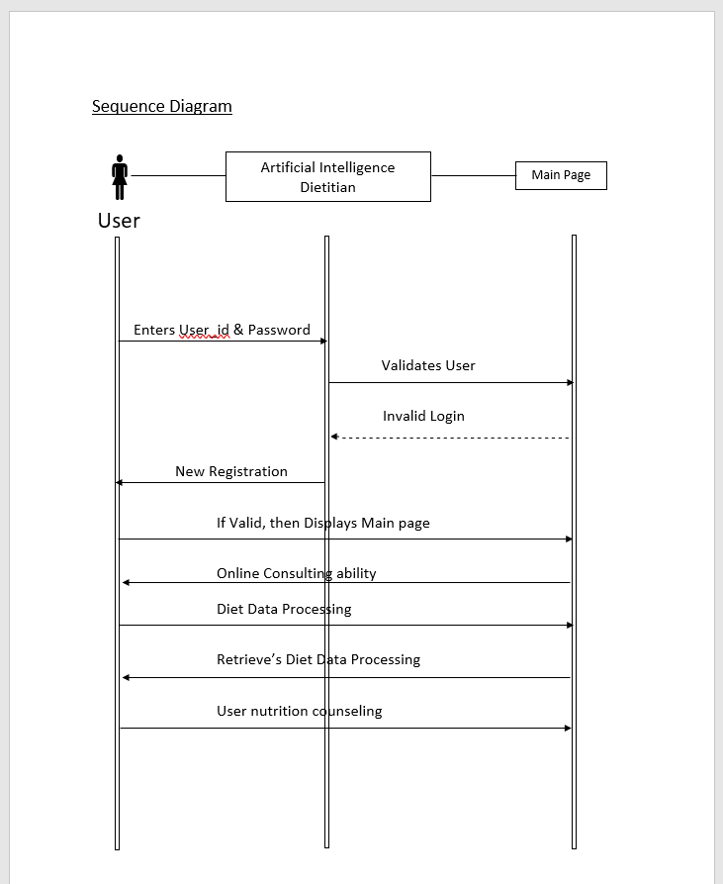
Design

Slide 17
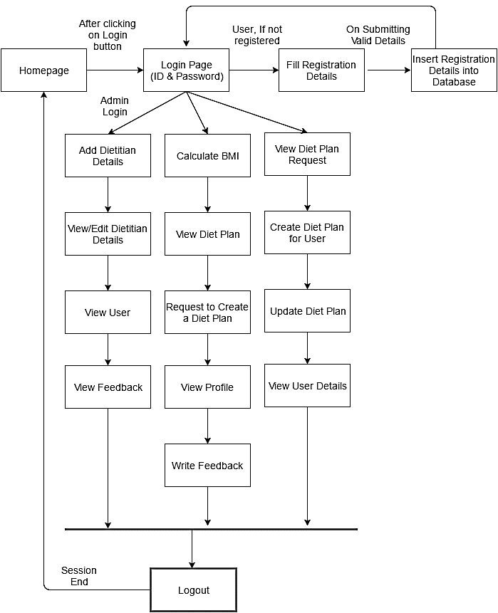
Design
System Architecture

Slide 18
Features
Load Balancing:
Since the system will be available only the admin logs in the amount of load on server will be limited to time period of admin access.
Easy Accessibility:
Records can be easily accessed and store and other information respectively.
User Friendly:
The Website will be giving a very user friendly approach for all user

Slide 19
Features
Efficient and reliable:
Maintaining the all secured and database on the server which will be accessible according the user requirement without any maintenance cost will be a very efficient as compared to storing all the customer data on the spreadsheet or in physically in the record books.
Easy maintenance:
Artificial Intelligence Dietitian website is design as easy way. So maintenance is also easy.

Slide 20
Technologies used
Front End Technology
Microsoft .NET Framework
.NET Framework Class Library
Windows GUI applications (Windows Forms).
Client Application Development
Server Application Development
ASP.NET applications.
XML Web services.
Windows services.

Slide 21

BACK END TECHNOLOGY
Client/Server
Microsoft SQL Server
Structured Query Language (SQL)

Slide 22
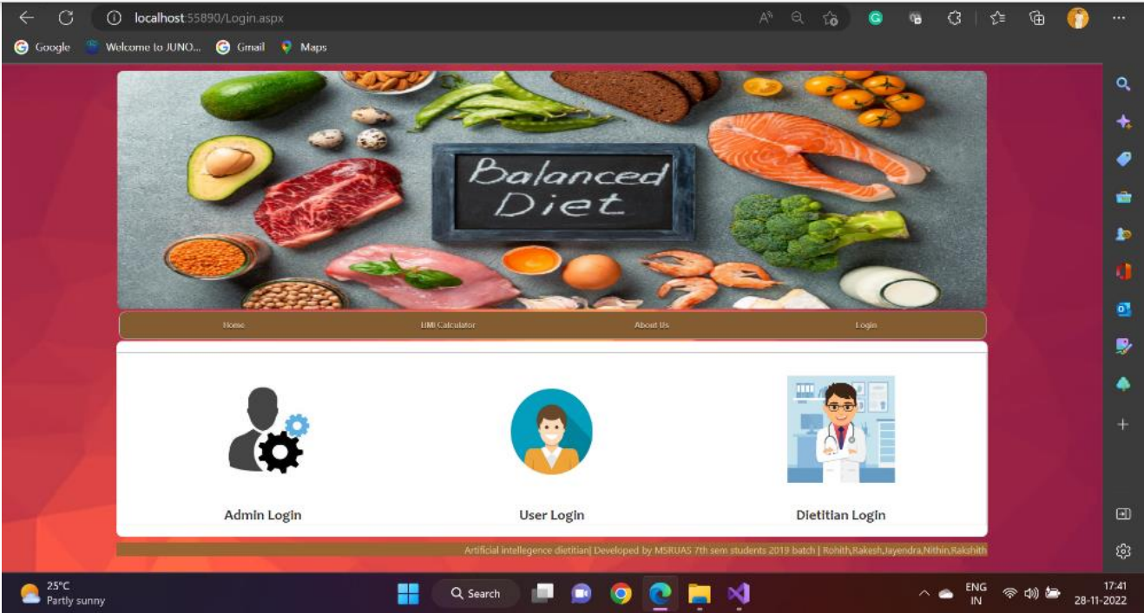
RESULTS

Slide 23
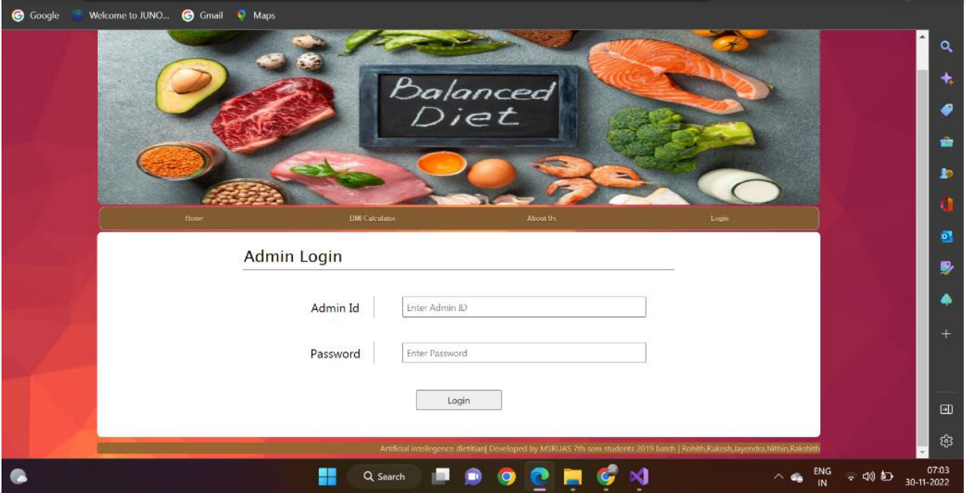
RESULTS

Slide 24
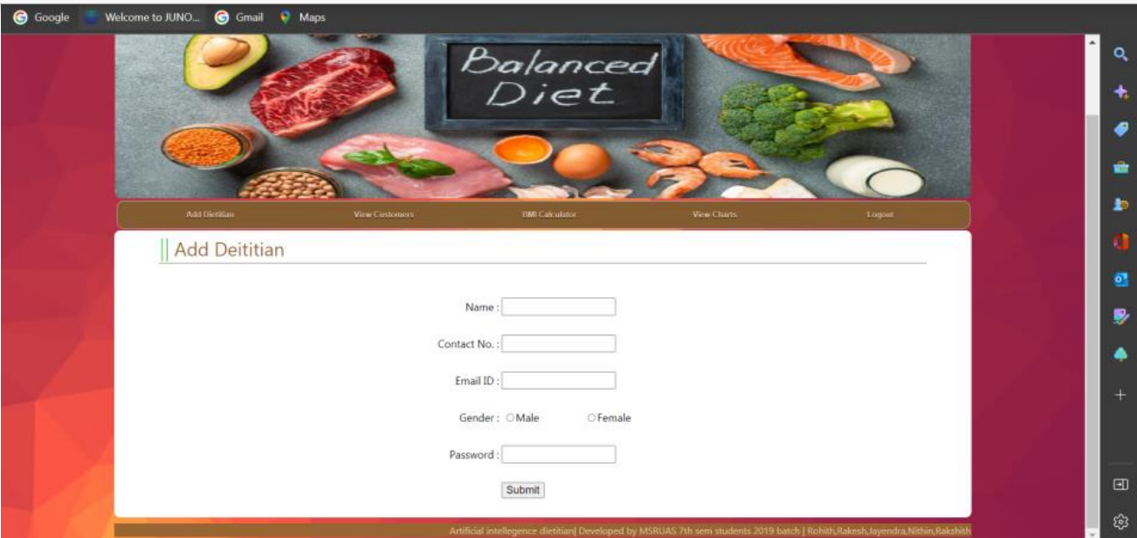
RESULTS

Slide 25
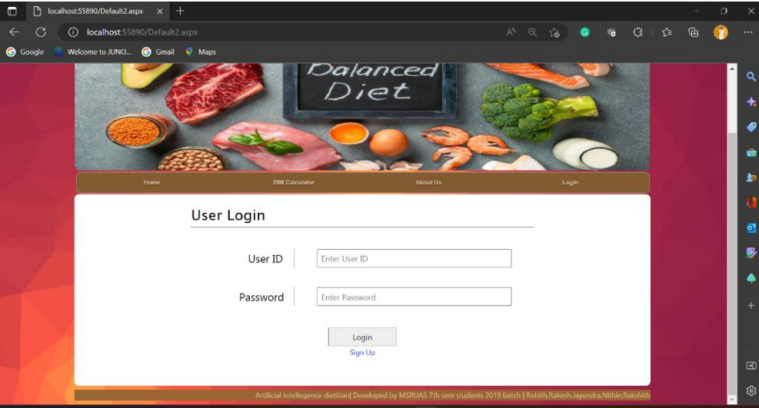
RESULTS

Slide 26
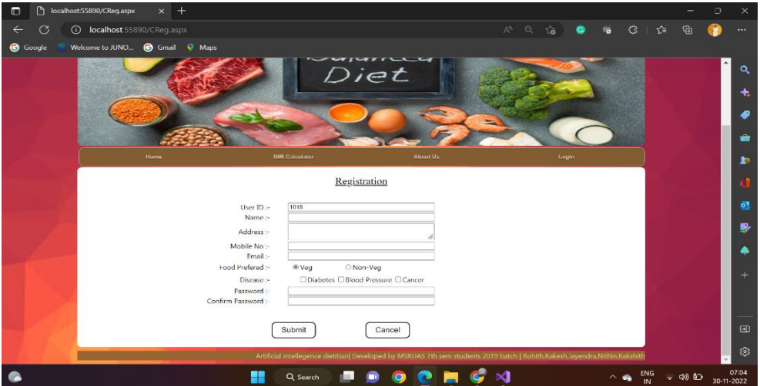
RESULTS

Slide 27
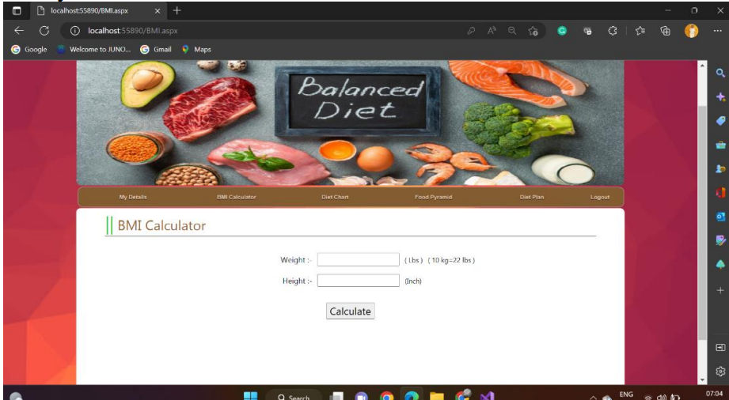
RESULTS

Slide 28
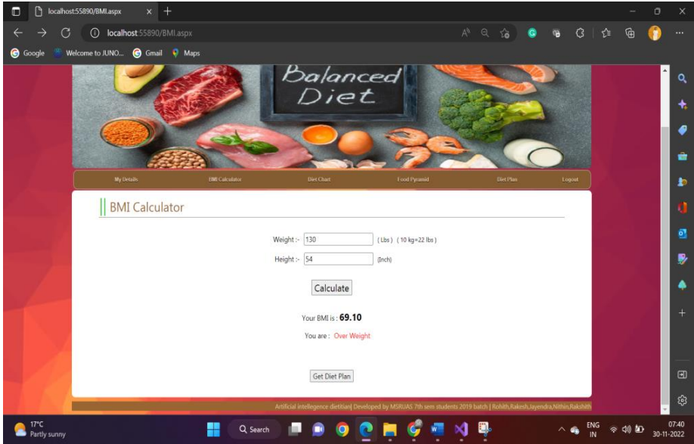
RESULTS

Slide 29
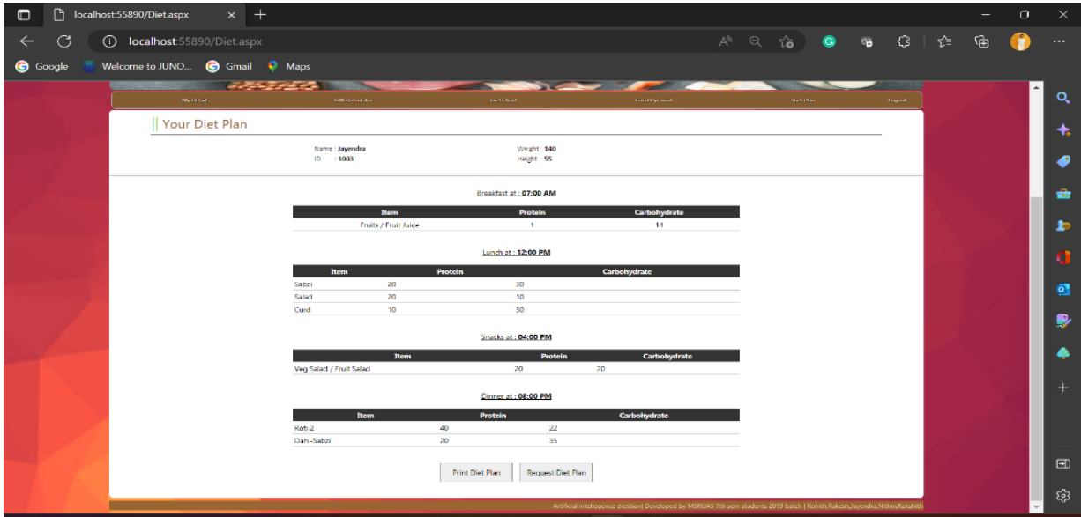
RESULTS

Slide 30
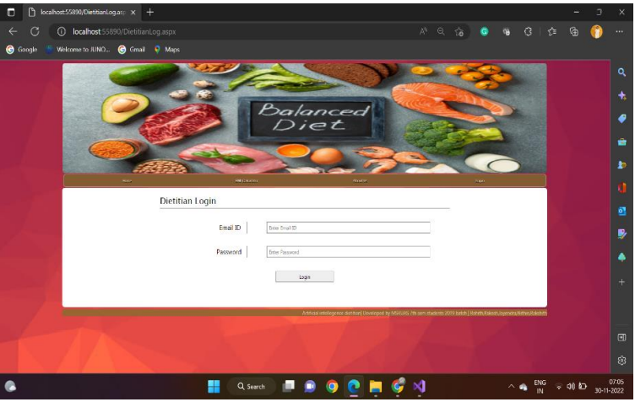
RESULTS

Slide 31
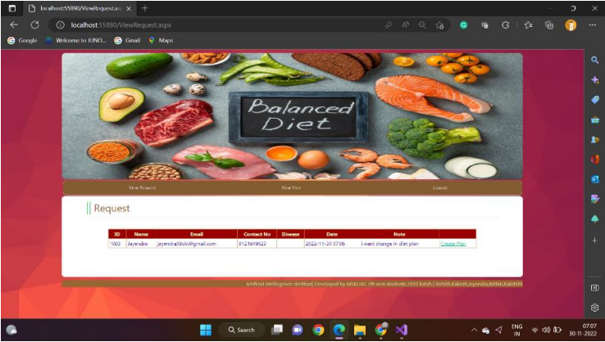
RESULTS

Slide 32
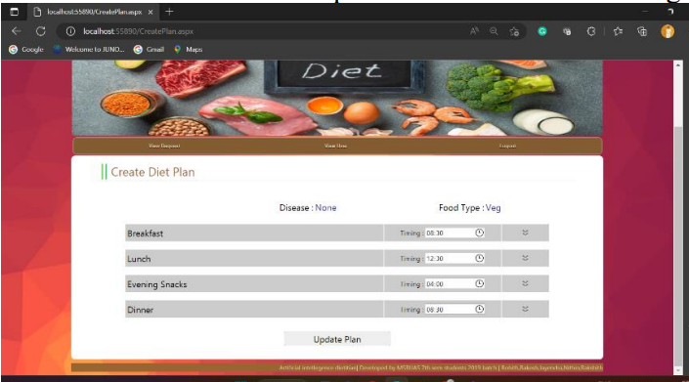
RESULTS

Slide 33
Cost Estimation
S.No. | Particulars/Components/Devices | Estimated Cost
1 | OPEN SOURSE SOFTWARE | FREE
2 | LITERATURE SURVEY | FREE
 | Total: | 0
Man hours:
Man hours per week (students): 6*5 students =30
Man hours per week (faculty): 3

Slide 34
Gantt Chart
Project Work (UG) 16 weeks
Week | 1 | 2 | 3 | 4 | 5 | 6 | 7 | 8 | 9 | 10 | 11 | 12 | 13 | 14 | 15 | 16
Major Activities
1.1
1.2
2.1
2.2
2.3
2.4
3.1
3.2
4.1
4.2
5.1
5.2
6.1
6.2

Slide 35
Gantt Chart
1) To conduct the literature review
2) To arrive at requirements
3) To design the prototype
4) To develop the prototype
5) To test the prototype
6) To document the project report

Slide 36
References
https://www.researchgate.net/publication/357352908_Artificial_Intelligence_Applications_in_Nutrition_and_Dietetics
https://www.nytimes.com/2022/03/14/well/eat/ai-diet-personalized.html
https://www.forbes.com/sites/ilkerkoksal/2020/03/07/how-ai-determines-the-diet-plans/?sh=7d29b7de3ed7

Slide 37
Thank You

